Slide 1
New Graduate Students Orientation August 18, 2023
Agenda
Welcome
MSME Program
Q & A
Advising

Slide 2
Faculty and Staff Introduction
https://www.sjsu.edu/me/about-us/faculty/full-time.php

Slide 3
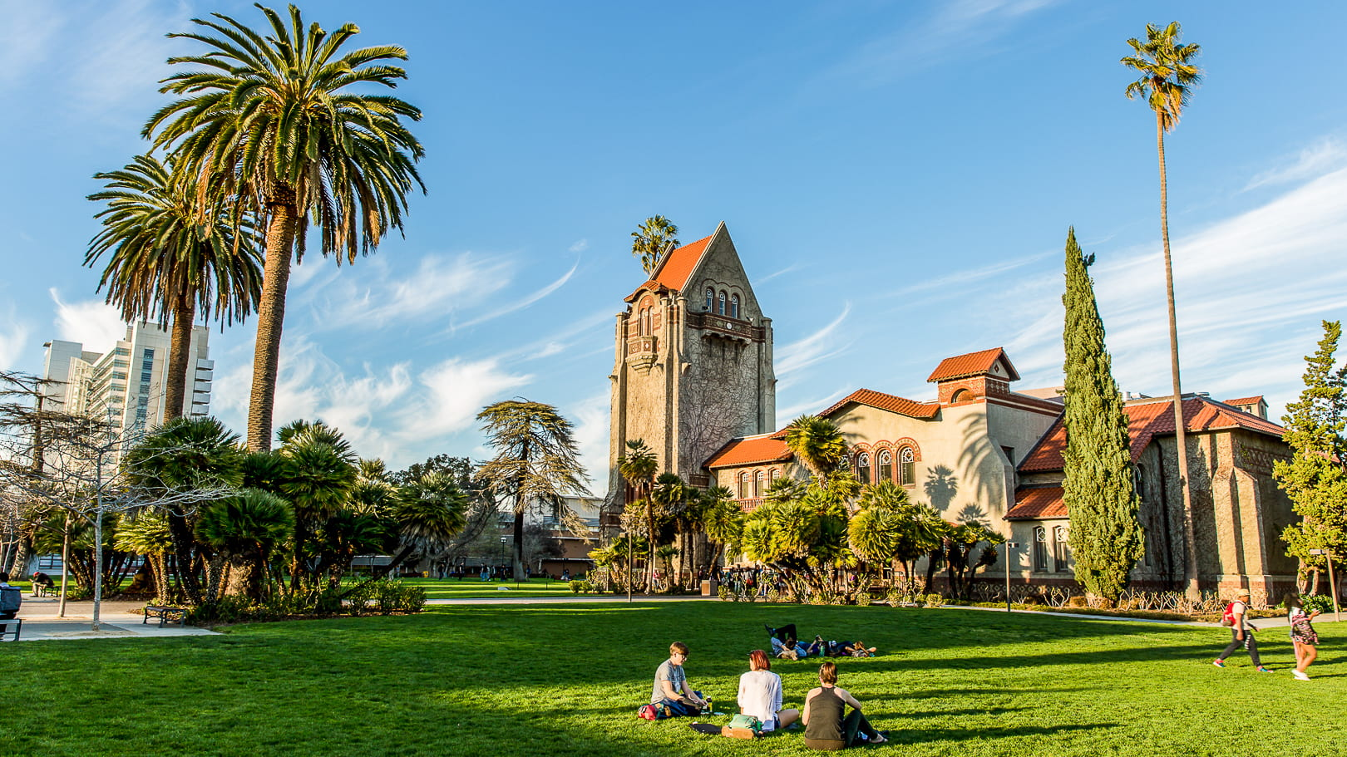
MSME Program
Evening classes

Slide 4
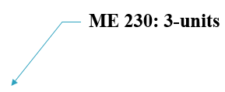
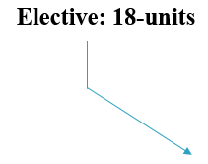
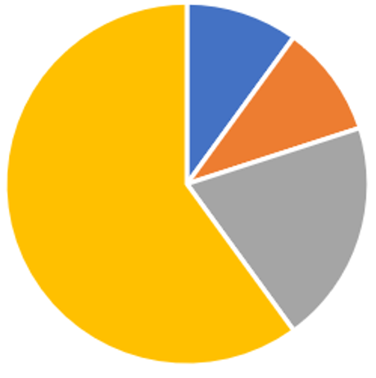


MSME Program
30-units Total

Slide 5
Overall minimum GPA of 3.0 or better
Grade in each of the 30 units for MS degree must be C or better (C- is an F)

Slide 6
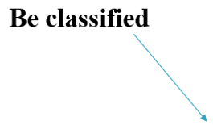
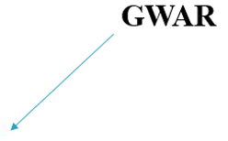



Program Requirements (30-units)

Slide 7
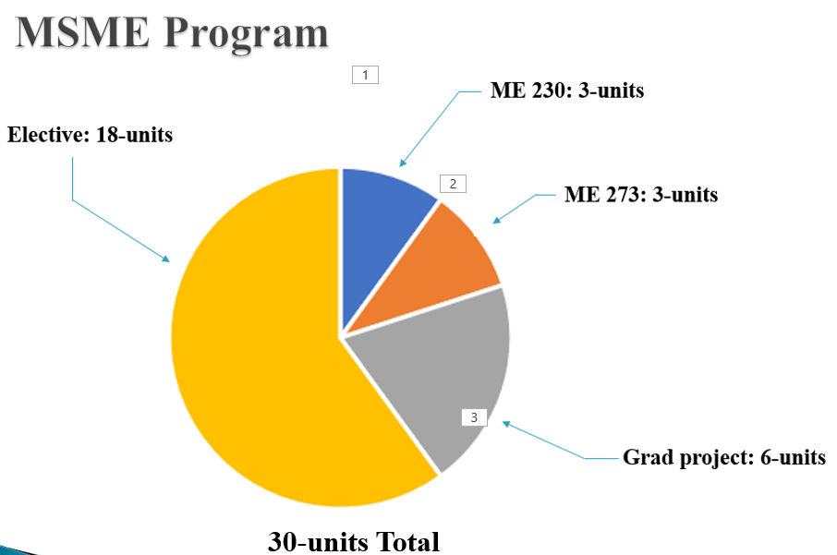



Approved Electives: 18-units
Which Courses Qualify as Electives
Any Graduate ME Course
Any ME Under grad Elective Course
Any Non-ME Course
Any Required ME Under grad Course
Any Non-ME Engineering Course

Slide 8
Approved Electives: 18-units
Which Courses Qualify as Electives
The list is located at:
chrome-extension://efaidnbmnnnibpcajpcglclefindmkaj/https://www.sjsu.edu/me/docs/msme-MSME%20Technical%20Electives-20230607.pdf

Slide 9
The list of Approved Electives
ME 135 – Intro to Composite Materials
ME 136 – Design for Manufacturability
ME 160 – Intro to Finite Element Method
ME 165 – Computer Aided Design in ME
ME 170 – Solar Energy Engineering o
ME 171 – Energy Management in Manufacturing
ME 172 – Alternative & Renewable Energy
ME 181 – Fundamentals of Biosensors
ME 183 – HVAC Systems Design
ME 185 – Hybrid and Electric Vehicle Fund.
ME 186 – Automotive Engineering
ME 187 – Automatic Control Systems Design
ME 189 – Design and Manuf. Of Microsystems
ME 192 – Robotics and Manufacturing Sys.

Slide 10
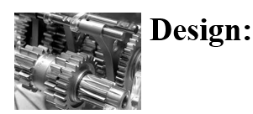
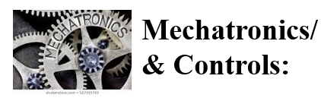
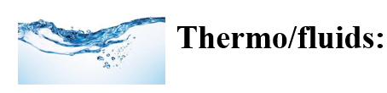
About the Program
Three Areas of emphasis:
  ME 240 ME 243, ME 250, ME 256, ME 260,
  ME 265, etc.
  ME 280, ME 281, ME 282, ME 283,
  ME 284, ME 285, etc.
  ME 200, ME 210, ME 211, ME
  221, ME 271. etc.

Slide 11
Program Notes
No rigid requirement for electives
You can pick and choose any ME Graduate courses
Generally, two courses/semester are offered in each area of emphasis
Up to 6 units can be below 200 level, selected from the approved elective course list. approval is required for any other 100-level elective course.
Up to 9 units of graduate level coursework can be transferred

Slide 12




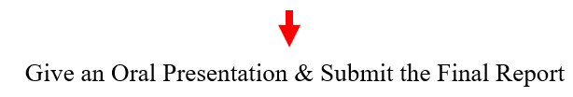

Steps for Graduation

Slide 13
Graduate Writing Assessment Requirement (GWAR)
The Graduate Writing Assessment Requirement (GWAR) is a university requirement
You must satisfy the GWAR before submitting the Candidacy form
GWAR can be satisfied by:
  Passing ME 201

Slide 14
How to satisfy the GWAR Requirements
Admitted Prior to Fall 2022
  CSU graduate or
  Has taken the department GWAR course (ME 265, ME 201)
Admitted in Fall 2022 or later
ME 201 or
Approval by the College of Graduate Studies (has a scholarly publication)

Slide 15



Steps for Completing Project/Thesis (6-units)

Slide 16
About the Oral Presentation (Project/Thesis)
Given at the end of a semester
½ hour Oral Exam at the end of the first term of Project/Thesis
One-hour Oral Exam at the end of the second term of Project/Thesis
A draft copy of the final report is due before the oral Defense and a bound copy is due after the Oral Defense

Slide 17
Advising
  There is no mandatory advising for removing academic hold.
  Contact the ME office if you can’t register for classes
  For any questions related to your MSME program, contact the Graduate Program Advisor
  Advising is required if you are on Probation
  There is no advising available during the semester breaks and holidays
  Advising Resource: https://www.sjsu.edu/me/msme/current_students/advising/

Slide 18
Registering for Classes
When eligible, you can register most of the courses online
You can add a class by getting an add code from the instructor (after the classes have started), except ME 201.
Graduate ME classes usually accommodate all
If you are Conditionally Classified and fulfilling a Conditional undergraduate class:
  Get an add code from the instructor (after the semester starts)
  Let the instructor know you are a graduate student and the Graduate Advisor has waived the pre-requisites
  Get written permission from the Graduate Advisor if needed

Slide 19
Registering for Classes
Classes You can’t Pre register
ME 295 A
ME 295 B
ME 299
ME 201

Slide 20
Probation and Disqualification
Probation: Overall GPA < 3.0
Disqualification: GPA < 3.0 two consecutive semesters
Reinstatement

Slide 21
Transfer Credits
Courses taken at other than SJSU Institutions
  Must be equivalent to the current SJSU courses
  Fill out an Equivalency Form and see the corresponding course instructor for evaluation
  Only a maximum of 9-units can be transferred
Courses taken at SJSU
  You can transfer up to 9-units of graduate ME courses completed as an SJSU undergraduate or taken on Open University. No pre-approval is required.

Slide 22
Resources
ME Web site:
https://www.sjsu.edu/me/

Slide 23
QUESTIONS
?

